Slide 1
CS306 - Recitation 3 RELATIONS AND REFERENTIAL INTEGRITY ER to RELATIONAL MODEL

Slide 2
DOMAIN CONSTRAINT
The type (domain) of each field is specified, and enforced by the DBMS whenever tuples are added or modified
CREATE TABLE students
(sid INTEGER,
name CHAR(50),
login CHAR(50),
age INTEGER,
gpa real);
INSERT INTO Students (sid, name, login, age, gpa) VALUES (53688, 'Shero', 'shero@cs', 18, 3.2);
Try this:
INSERT INTO Students (sid, name, login, age, gpa)VALUES (53689, 'Shero', 'shero@cs', '18 age', 3.2);

Slide 3
PRIMARY KEY
The PRIMARY KEY constraint uniquely identifies each record in a table.
ALTER TABLE Students ADD PRIMARY KEY (sid);
CREATE TABLE courses
(cid INTEGER,
cname CHAR(30),
grade char(1),
PRIMARY KEY (cid));

Slide 4
FOREIGN KEY
A FOREIGN KEY is a key used to link two tables together.
A FOREIGN KEY is a field in one table that refers to the PRIMARY KEY in
another table.
CREATE TABLE enrolled(
sid INTEGER,
cid INTEGER,
FOREIGN KEY (sid) REFERENCES students(sid) ON DELETE SET NULL,
FOREIGN KEY (cid) REFERENCES courses(cid) ON UPDATE CASCADE);

Slide 5
Referential Integrity
• ON DELETE CASCADE: if a row of the referenced table is DELETED, then all matching rows in the
referencing table are also DELETED
• ON UPDATE CASCADE: if a row of the referenced table is UPDATED, then all matching rows in the
referencing table are also UPDATED
• ON DELETE SET NULL: if a row of the referenced table is deleted, then all referencing columns in all
matching rows of the referencing table to be set to null
• ON DELETE SET DEFAULT: if a row of the referenced table is deleted, then all referencing columns in all
matching rows of the referencing table to be set to the column’s default value.
CREATE TABLE enrolled(
sid INTEGER,
cid INTEGER,
FOREIGN KEY (sid) REFERENCES students(sid) ON DELETE SET NULL,
FOREIGN KEY (cid) REFERENCES courses(cid) ON UPDATE CASCADE);

Slide 6
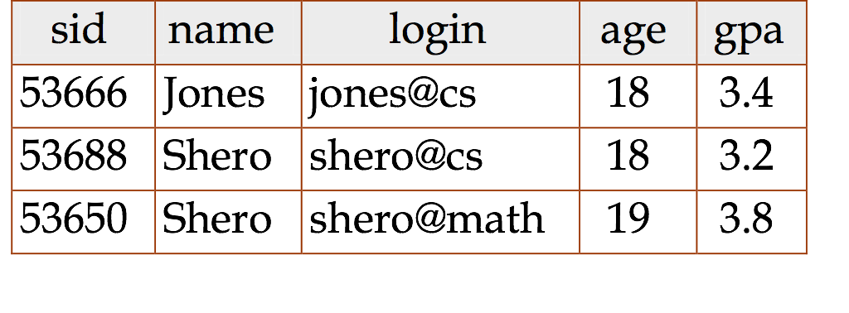
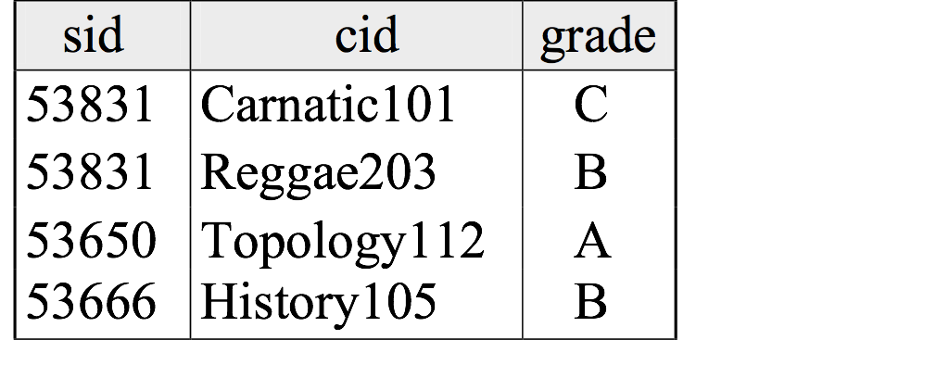
EXERCISE
Inserting some values to check referential integrity:
INSERT INTO enrolled VALUES (1,’Hasan’,’hasan@cs’,25,3.5)
Deleting some values to check referential integrity holds:
DELETE FROM students WHERE sid = 53650
Updating some values to check referential integrity holds:
UPDATE students SET sid = 60000 WHERE sid = 53666

Slide 7
VIEW
A view is just a relation, but we store a definition, rather than a set of tuples.
CREATE VIEW goodStudents (sid, gpa)
AS SELECT S.sid, S.gpa
FROM students S
WHERE S.gpa > 3;
DROP VIEW goodStudents;

Slide 8
VIEW
A view is just a relation, but we store a definition, rather than a set of tuples.
CREATE VIEW goodStudents (sid, gpa)
AS SELECT S.sid, S.gpa
FROM students S
WHERE S.gpa > 3;
DROP VIEW goodStudents;

Slide 9
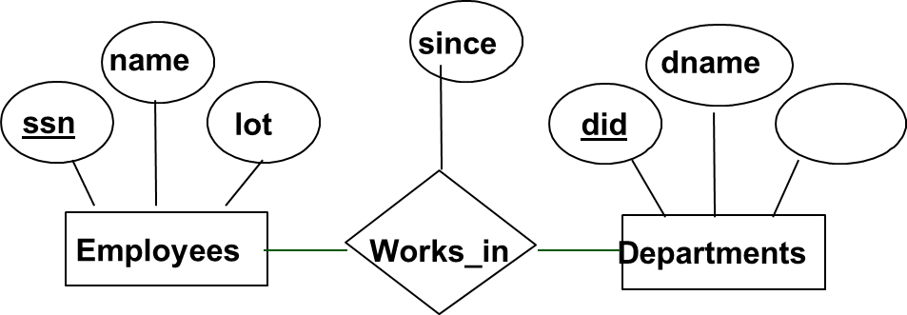
Many to many relationship
CREATE TABLE Employees(
ssn CHAR(11),
name CHAR(20),
lot INTEGER,
PRIMARY KEY (ssn));
CREATE TABLE Employees(
ssn CHAR(11),
name CHAR(20),
lot INTEGER,
PRIMARY KEY (ssn));

Slide 10
Many to many relationship
CREATE TABLE Works_in(
ssn CHAR(11),
did INTEGER,
since DATE,
PRIMARY KEY (ssn, did),
FOREIGN KEY (ssn) REFERENCES employees(ssn),
FOREIGN KEY (did) REFERENCES departments(did));

Slide 11
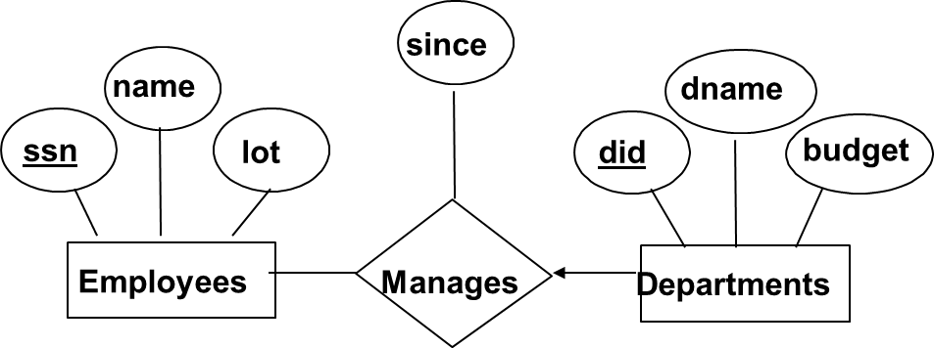
Key constraint
CREATE TABLE Employees(
ssn CHAR(11),
name CHAR(20),
lot INTEGER,
PRIMARY KEY (ssn));
CREATE TABLE Dept_Manages(
did CHAR(11),
ssn CHAR(11),
dname CHAR (20),
budget INTEGER,
since DATE,
PRIMARY KEY (did),
FOREIGN KEY ssn REFERENCES Employees(ssn)
);

Slide 12
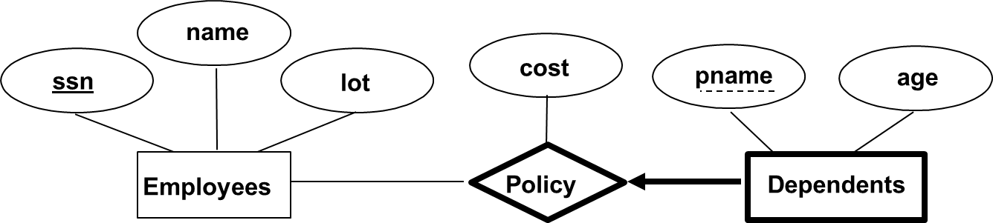
Identifying relationship Weak Entity set
CREATE TABLE Employees(
ssn CHAR(11),
name CHAR(20),
lot INTEGER,
PRIMARY KEY (ssn));
CREATE TABLE Dep_Policy(
pname CHAR(11),
age INTEGER,
cost DECIMAL,
ssn CHAR(11),
PRIMARY KEY (ssn,pname)
FOREIGN KEY ssn REFERENCES Employees(ssn) ON DELETE CASCADE
);

Slide 13
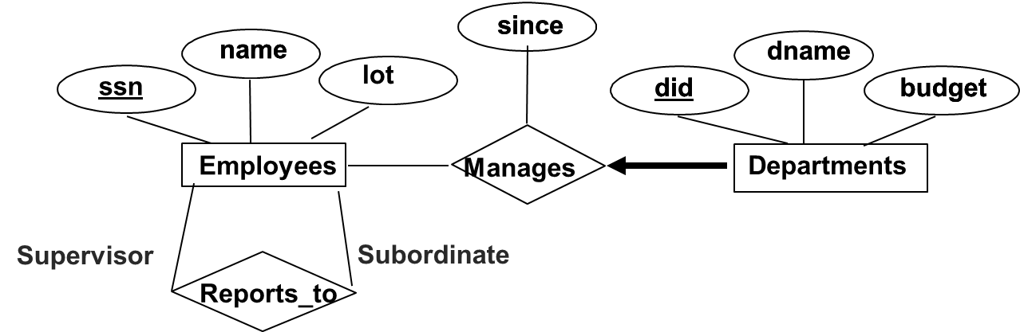
How many relations will there be, after we convert the following ER diagram to relational model?

Slide 14
CREATE TABLE Employees(
ssn CHAR(11),
name CHAR(20),
lot INTEGER,
PRIMARY KEY (ssn));
CREATE TABLE Reports_To(
supervisor_ssn CHAR(11),
subordinate_ssn CHAR(11),
PRIMARY KEY (supervisor_ssn,subordinate_ssn),
FOREIGN KEY supervisor_ssn REFERENCES Employees(ssn) ON DELETE CASCADE,
FOREIGN KEY subordinate_ssn REFERENCES Employees(ssn) ON DELETE CASCADE,
);
CREATE TABLE Dept_Manages(
did CHAR(11),
ssn CHAR(11) NOT NULL,
dname CHAR (20),
budget INTEGER,
since DATE,
PRIMARY KEY (did),
FOREIGN KEY ssn REFERENCE Employees(ssn));

Slide 15
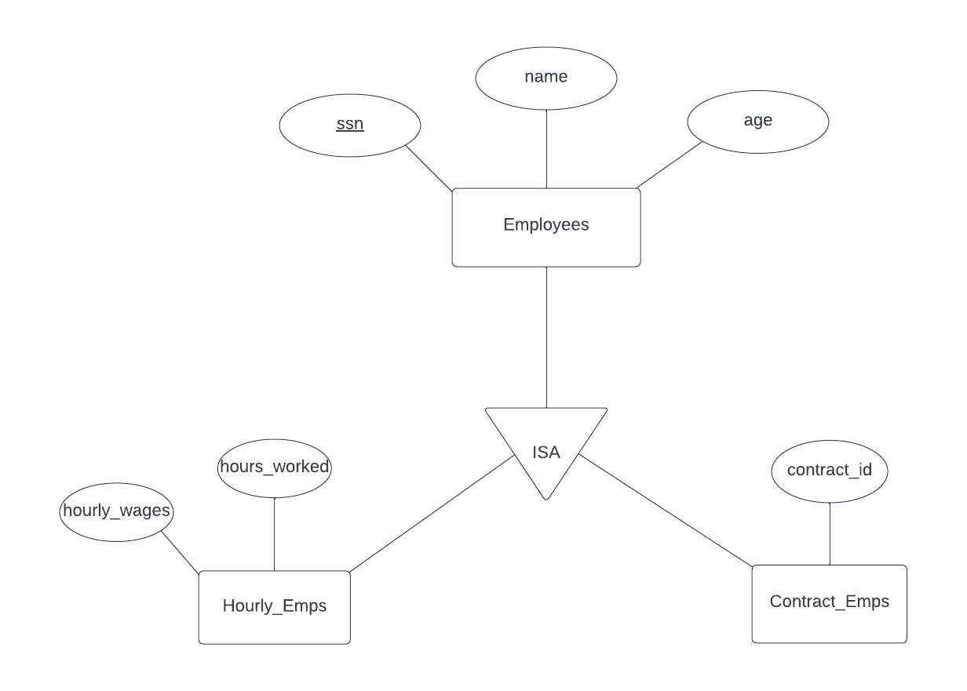
CREATE TABLE Employees(
ssn CHAR(11),
name CHAR(20),
age INTEGER,
PRIMARY KEY (ssn)
)
CREATE TABLE Hourly_Emps(
ssn CHAR(11),
Hours_worked INTEGER,
Hourly_wages DECIMAL,
PRIMAY KEY (ssn),
FOREIGN KEY (ssn) References Employees(ssn) ON DELETE CASCADE
)
CREATE TABLE Contract_Emps(
ssn CHAR(11),
contract_id INTEGER,
PRIMAY KEY (ssn),
FOREIGN KEY (ssn) References Employees(ssn) ON DELETE CASCADE
)

Slide 16
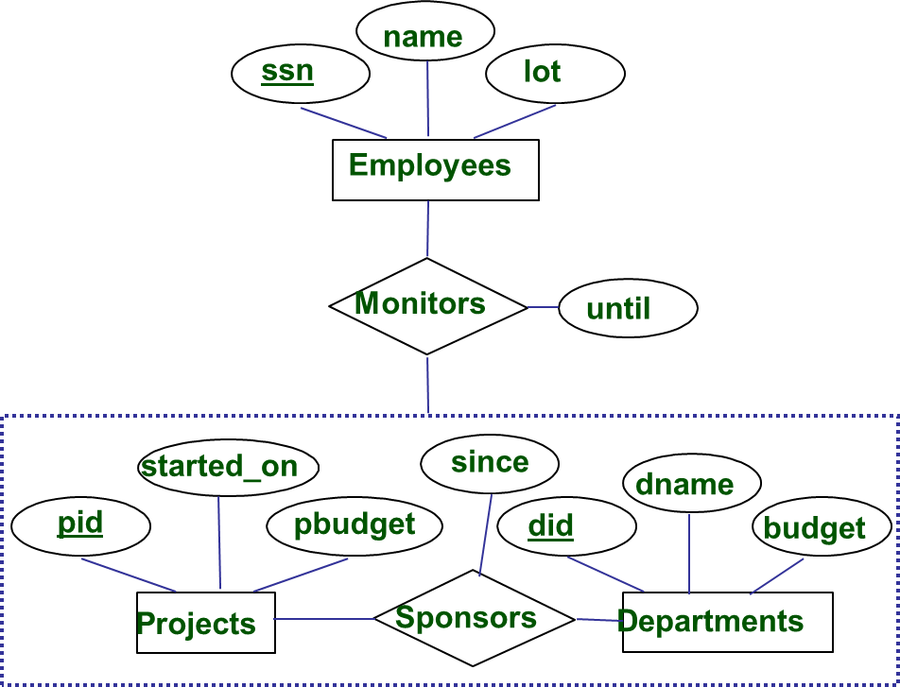
Have to record the descriptive attributes of Sponsors relationship.
Not every sponsorship has a monitor, some (pid, did) pairs in the
Sponsors relation may not appear in the Monitors relation.

Slide 17
CREATE TABLE Monitors(
ssn CHAR(11),
pid CHAR(11),
did CHAR(11),
until DATE,
PRIMARY KEY (ssn,pid,did)
FOREIGN KEY ssn REFERENCES Employees,
FOREIGN KEY pid REFERENCES Projects,
FOREIGN KEY did REFERENCES Departments
)
CREATE TABLE Employees(
ssn CHAR(11),
name CHAR(20),
lot INTEGER,
PRIMARY KEY (ssn)
)
CREATE TABLE Projects(
pid CHAR(11),
started_on DATE,
Pbudget DECIMAL,
PRIMARY KEY (pid)
)
CREATE TABLE Sponsors(
pid CHAR(11),
did CHAR(11),
Since DATE,
PRIMARY KEY (pid,did),
FOREIGN KEY pid REFERENCES Projects(pid),
FOREIGN KEY (did) REFERENCES Departments(did)
)
CREATE TABLE Departments(
did CHAR(11),
dname CHAR(20),
budget DECIMAL,
PRIMARY KEY (pid)
)

